Slide 1

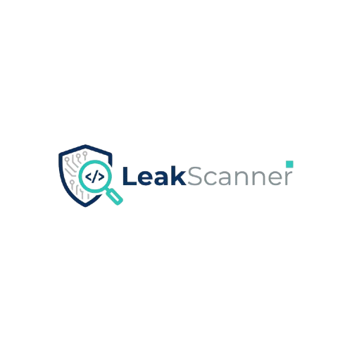
GitHub
SECRET SCANNER AND LEAKAGE HUNTER
Tharupathi Bandaranayake
Cybersecurity Undergraduate
10th November 2025

Slide 2
Together, we can bridge the gap between data exposure and digital trust.
LeakScanner empowers organizations
To detect and prevent code and credential leaks,
Ensuring technology access remains secure and responsible.

Slide 3
OUR MISSION
To revolutionize how organizations secure their digital assets by making leak detection accessible, intelligent, and privacy first.
Through collaboration, automation, and innovation, LeakScanner empowers businesses to identify exposed secrets and protect their reputation before breaches occur.

Slide 4
LEAKSCanner – Secure Innovation for the Modern Enterprise
LeakScanner is an intelligent, configuration-based leak detection tool designed to help organizations identify exposed secrets, credentials, and proprietary code before they cause damage.
Whether used by startups or large enterprises, LeakScanner delivers accuracy, scalability, and full control ensuring data protection becomes a built-in part of innovation.
The system offers per-tenant customization through JSON-based configurations, allowing companies to define their own keywords, patterns, and risk profiles. With support for AI-assisted validation and local-first privacy, LeakScanner bridges the gap between usability and security.

Slide 5

PRODUCT #1 – LEAKSCANNER
LeakScanner is an intelligent, configuration-based leak detection system built to identify exposed credentials, API keys, and proprietary code across public repositories like GitHub.
The product combines regex-based pattern recognition with optional AI validation (Google Gemini) to provide context-aware results and reduce false positives. Its per-tenant configuration structure allows organizations to define unique scanning profiles while maintaining full local data privacy.
Designed for both enterprises and cybersecurity learners, LeakScanner delivers reliability, flexibility, and insight — helping teams detect leaks before they become threats.
Analytics-driven / Multi-tenant / AI-powered / Local-first / Scalable

Slide 6
PRODUCT #2
FUTURE VERSION / COMMERCIAL EXPANSION
The next phase of LeakScanner focuses on expanding beyond a local scanning tool into a cloud-integrated enterprise platform with centralized management and automation.
LeakScanner Enterprise will feature:
  Centralized Dashboard - Manage multi-tenant configurations and scan results from one secure web interface.
  Automated CI/CD Integration - Seamless plug-ins for GitHub Actions, Jenkins, and AWS Lambda for real-time leak prevention.
  AI-Assisted Threat Scoring - Intelligent triaging of leak severity using machine learning models trained on large vulnerability datasets.
  End-to-End Encryption - Ensures sensitive customer data and tokens remain private even in hosted deployments.
  Subscription Model (SaaS) - A commercial tier offering real-time monitoring, reporting, and support for enterprises.
This expansion bridges open-source accessibility with enterprise-grade reliability — paving the way for LeakScanner Cloud, a globally deployable secret detection ecosystem.

Slide 7
SIZE OF MARKET
TAM
The global Code Security and Secret Detection market is valued at approximately $4.8 billion (2025)
This includes enterprises investing in software supply chain protection, DevSecOps, and data leak prevention.
4.8B
SAM
An estimated $1.3 billion of this market consists of companies actively integrating source code scanning, credential management, and repository monitoring tools.
These are primarily managed security service providers (MSSPs), large enterprises, and security-conscious SMEs.
1.3B
SOM
LeakScanner focuses on the $310 million segment of small to mid-sized businesses, educational institutions, and developer teams seeking a cost-effective, local-first, and privacy-preserving leak detection tool that doesn’t rely on cloud uploads or subscriptions.
310M

Slide 8
COMPETITIVE ANALYSIS
Existing tools such as Gitleaks, GitGuardian, and TruffleHog dominate the code-leak detection space, focusing mainly on large-scale, cloud-hosted scanning solutions.
LeakScanner differentiates itself by offering a local-first, multi-tenant, and configuration-driven architecture giving users full control over their data while maintaining flexibility for enterprise or academic use.
Unlike cloud platforms that store and analyze code remotely, LeakScanner allows organizations to scan repositories securely within their own environment. It also integrates optional AI-assisted verification to minimize false positives and prioritize findings based on severity.
Through this privacy-preserving, modular approach, LeakScanner bridges the gap between open-source simplicity and enterprise-grade security.

Slide 9
Thank you!
Tharupathi Bandaranayake
Cybersecurity Undergraduate
10th November 2025

